Slide 1

SMS spam classification using NLP: Methods, approaches, and applications
By Anisha Agarwal

Slide 2
Introduction
The easy accessibility and simplicity of SMS have made it attractive to malicious users thereby incurring unnecessary costing on the mobile users and also the Secure Mobile Message Communication is jeopardized.
Thus, this article is to identify and review existing state-of-the-art methodology for SMS spam classification based on certain metrics: ML and AI methods and techniques, approaches, and deployed environment.

Slide 3
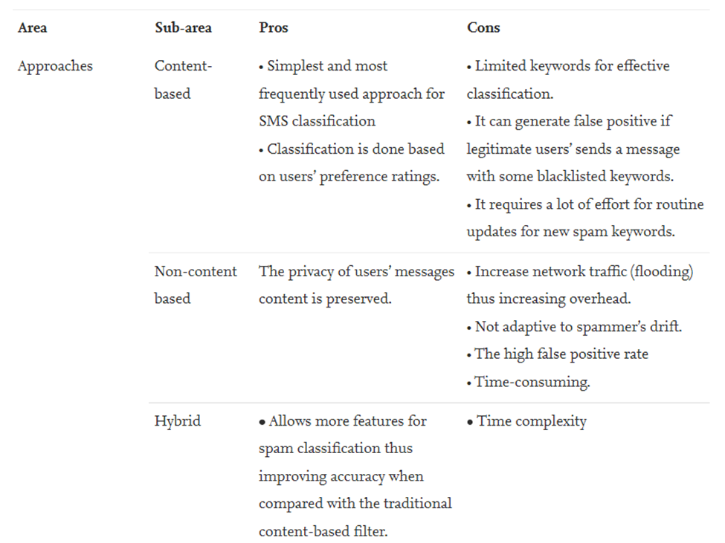
Approach

Slide 4
Import the required Libraries.
Data Preprocessing.
Bag of Words.
Adding new Feature. Like- Length of the text, Profanity of the text, Parts of Speech(POS).
EDA of the dataset.
Word Tokenization.
Implementing different ML classifying models. Like- LogisticRegression, MultinomialNB, RandomForestClassifier, LinearSVC, SGDClassifier, GradientBoostingClassifier. And compare these to find which Model is best for this classification.
Implementation

Slide 5
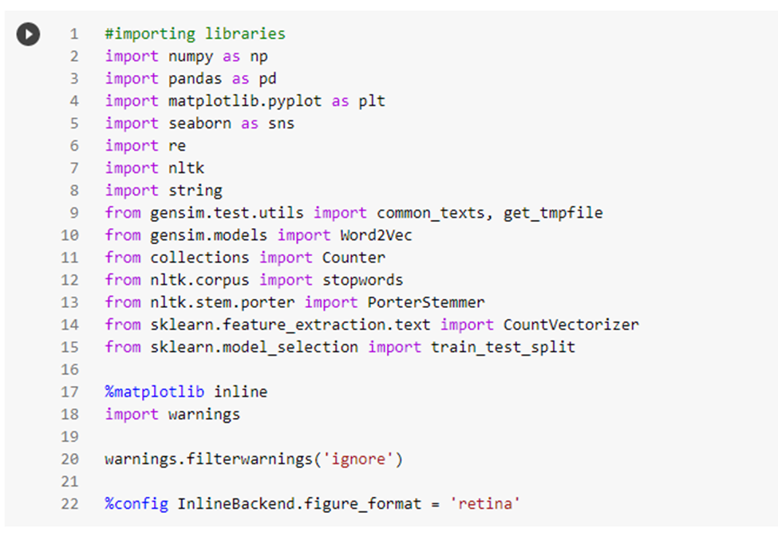
Libraries

Slide 6
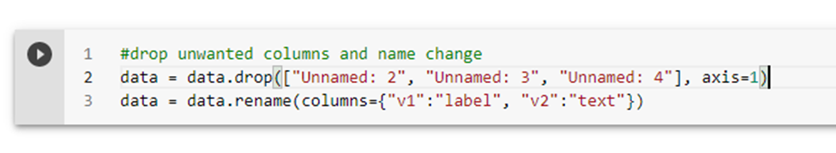
Data Preprocessing
Removing unnecessary columns and renaming features name.

Slide 7
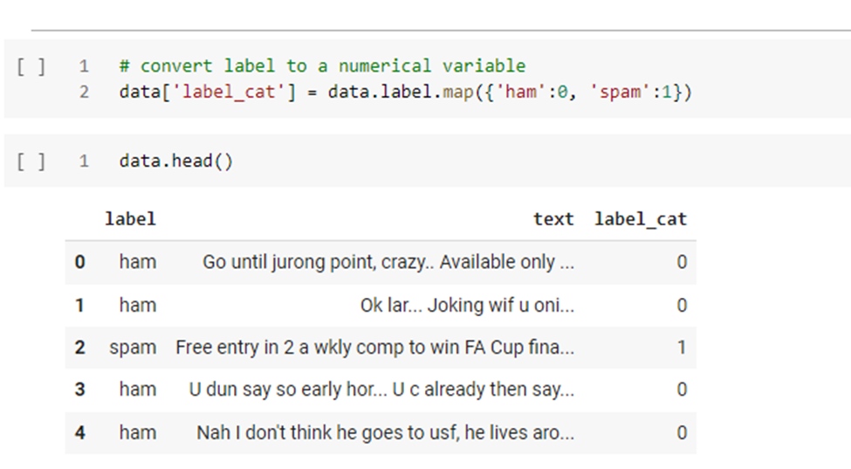
Data Preprocessing:
2. Numericalizing categorical feature which is our label (ham or sam).

Slide 8
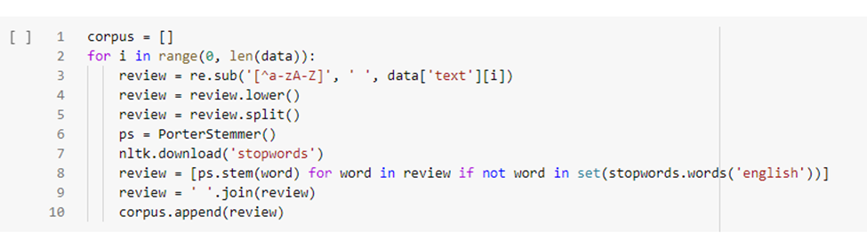
Data Preprocessing:
3. Generating corpus from raw sms messages (stopwords,lowering,stemming).

Slide 9
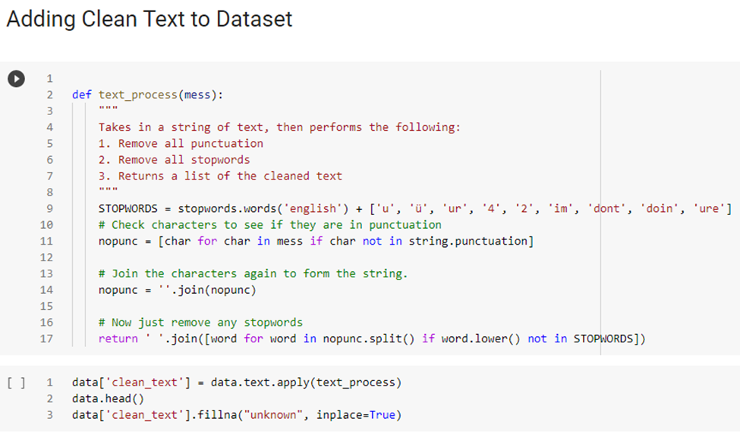
Data Preprocessing:

Slide 10
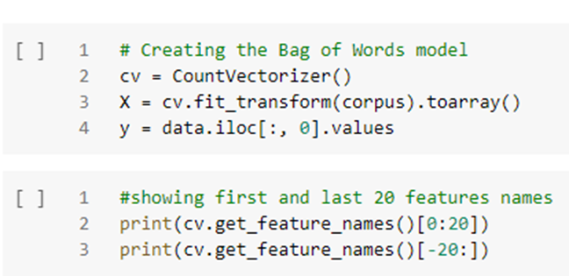
Data Preprocessing:
4. Creating bag of words model using CountVectorizer.

Slide 11
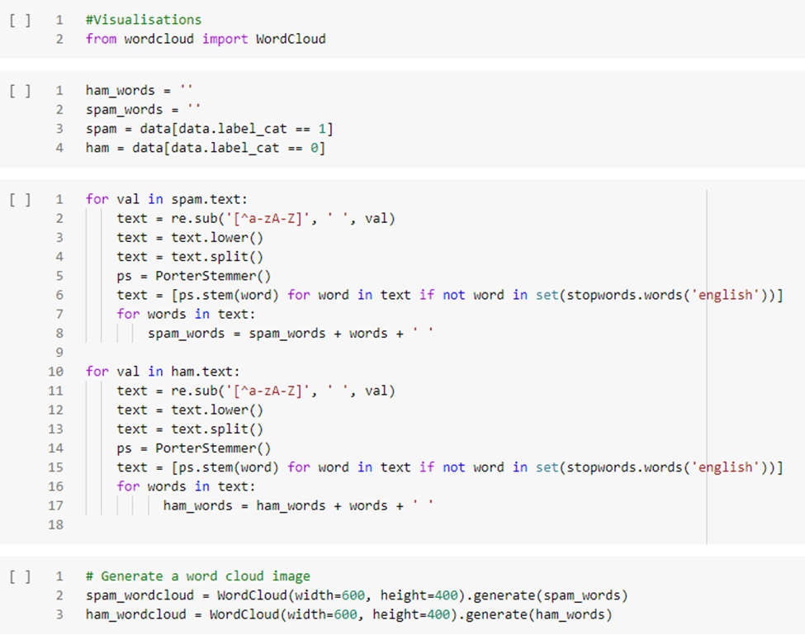
Bag of Words: Code to Generate Bag of Words

Slide 12
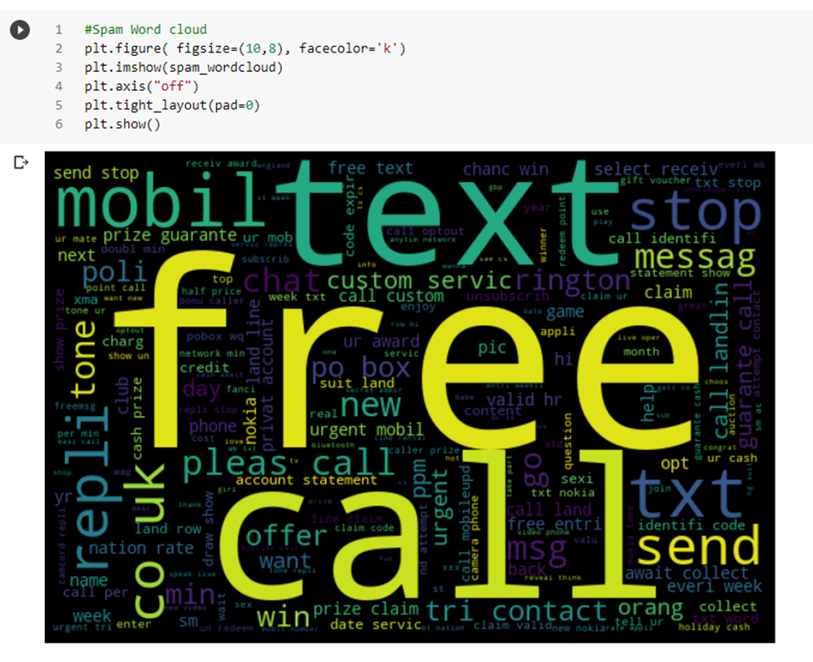
Code to plot Word of Cloud Spam Words

Slide 13
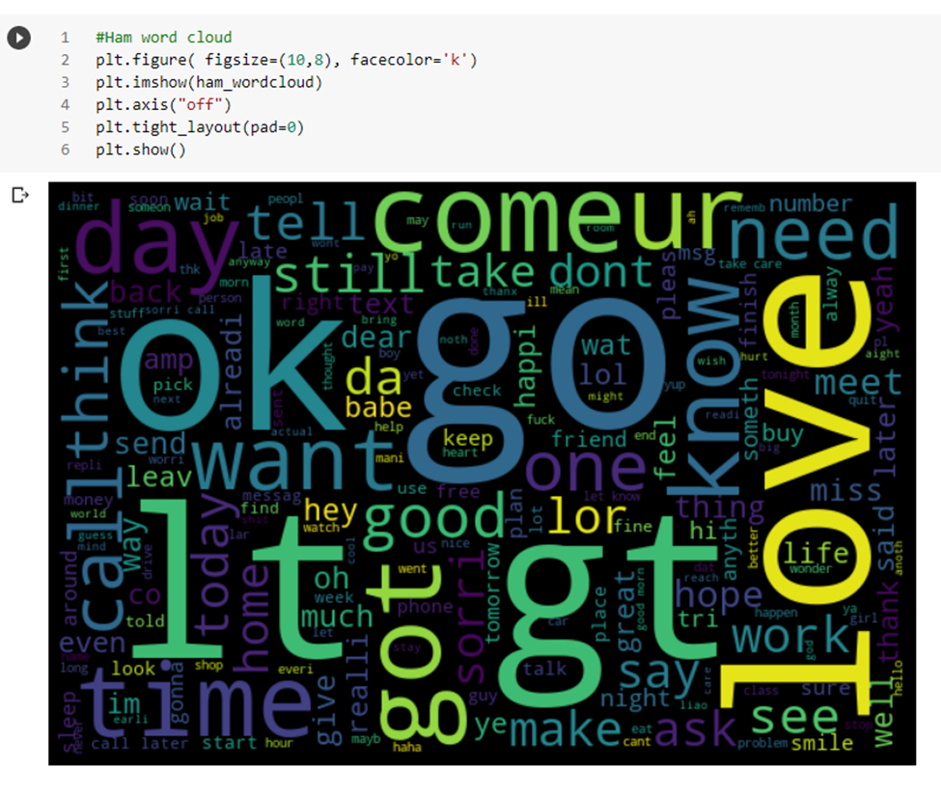
Code to plot Word of Cloud Ham Words

Slide 14
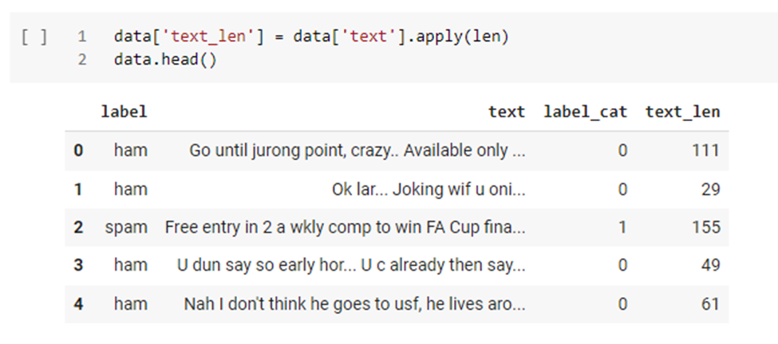
New Features added: Length of Text

Slide 15
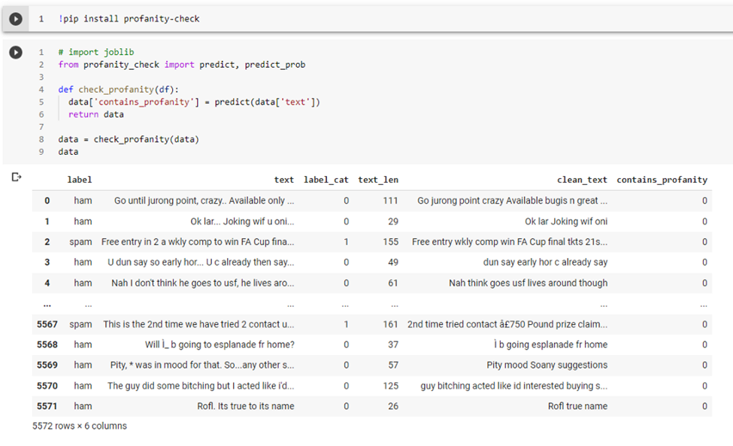
New Features added: Profanity Check

Slide 16
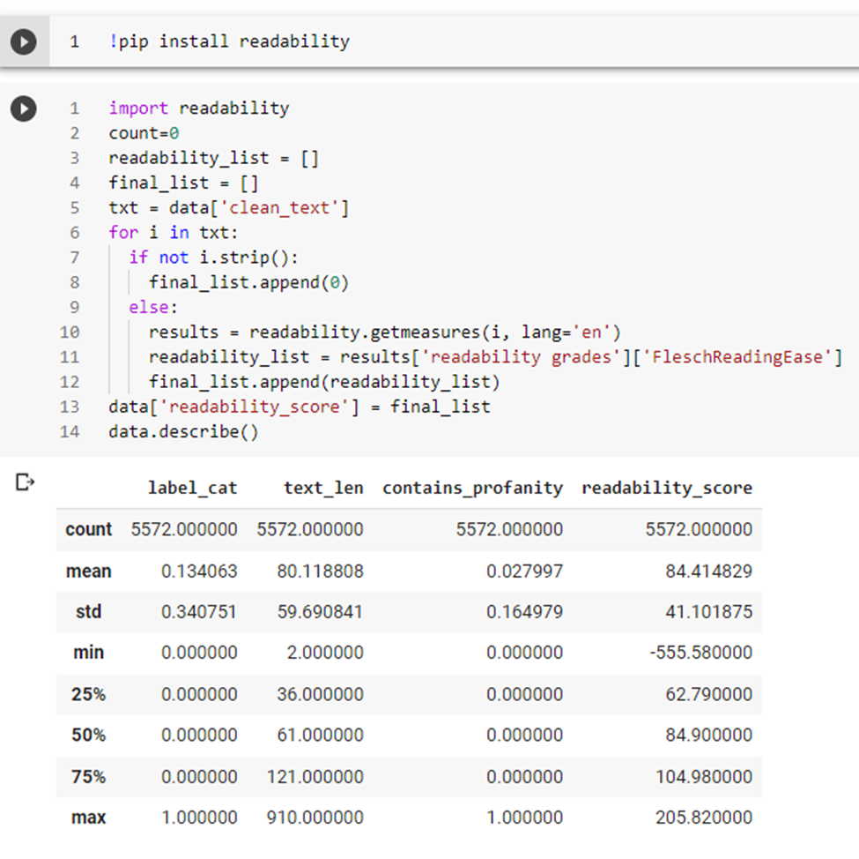
New Features added: Readability Score

Slide 17
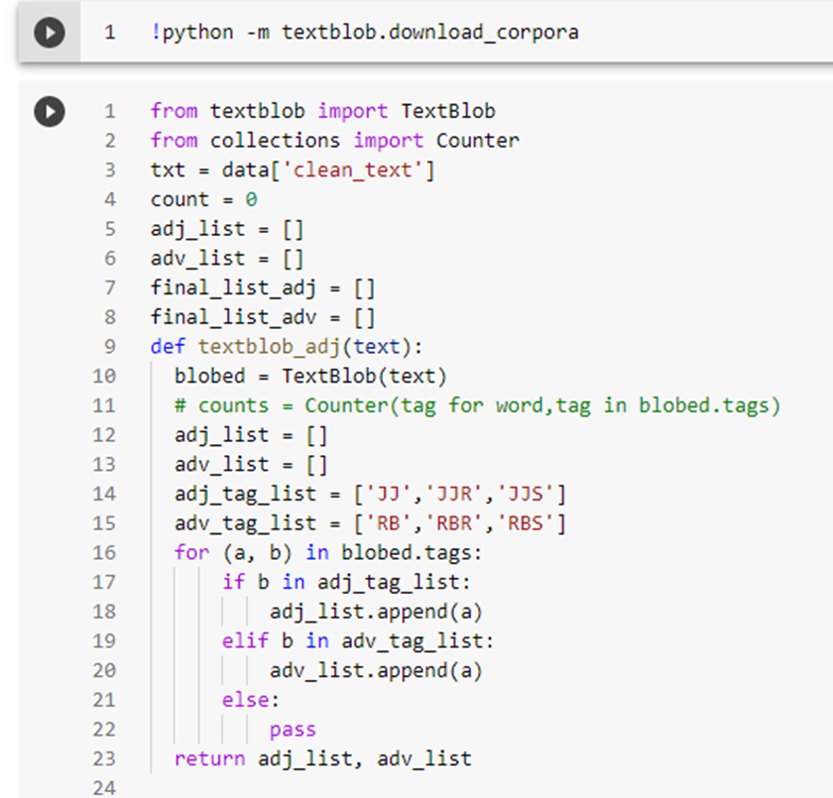
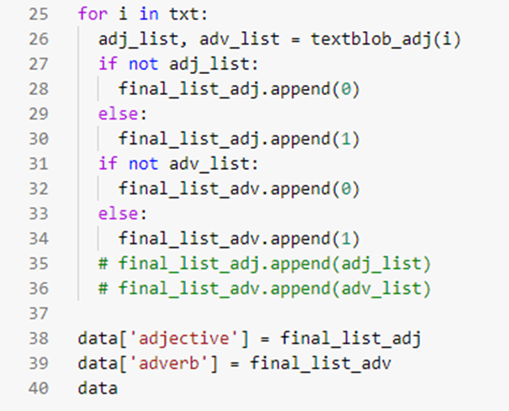
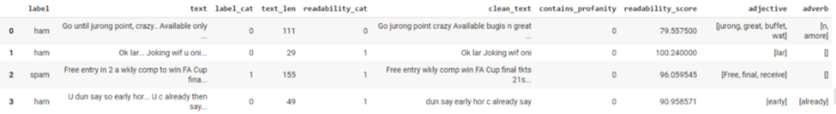
New Features added: Parts of Speech (POS)

Slide 18
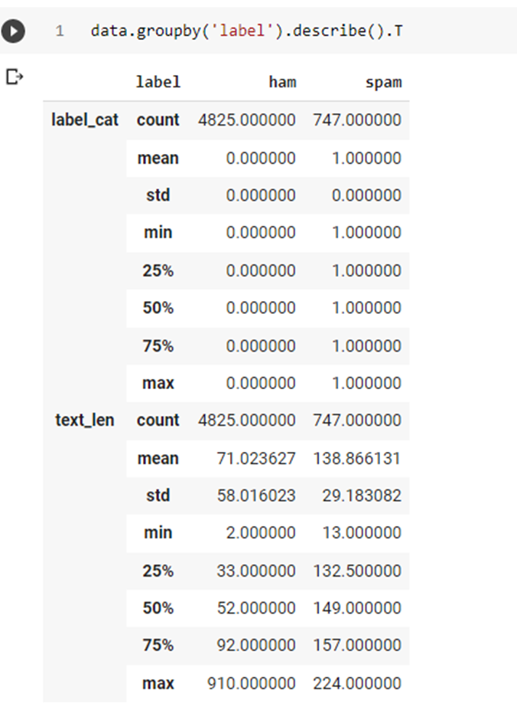
Exploratory Data Analysis:

Slide 19
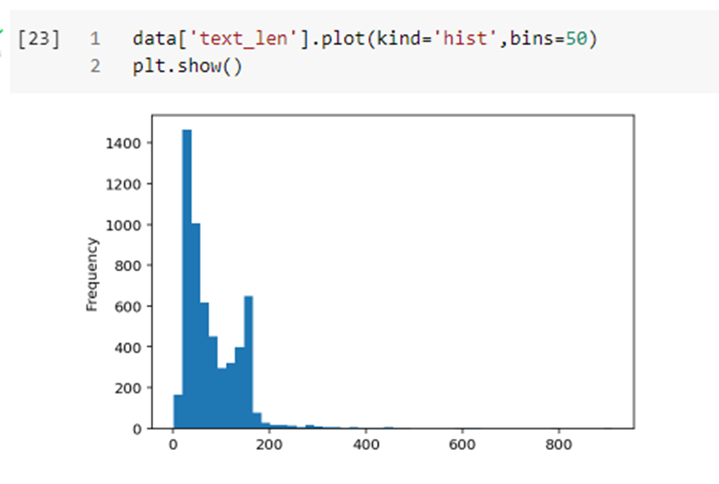
Maximum Length of the Text Plotted

Slide 20
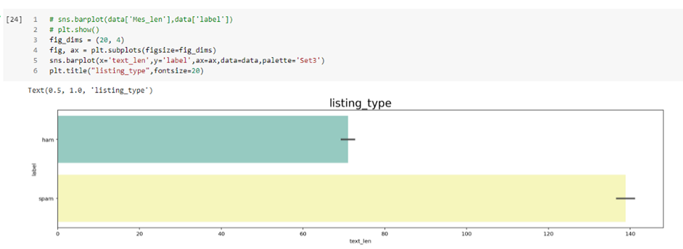
Spam and Ham Text against the Length

Slide 21
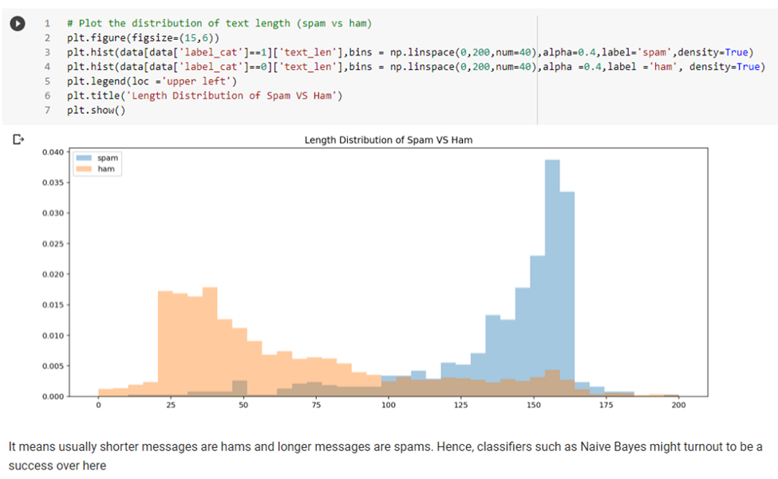
Distribution of text length

Slide 22
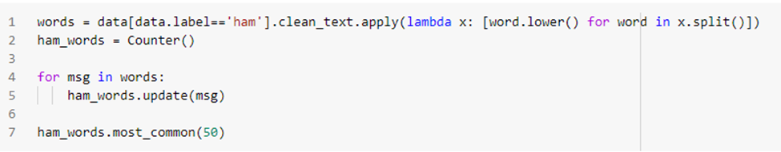
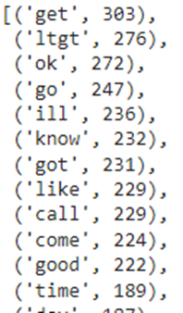
Ham Tokenization for first 50 Words:
OutPut

Slide 23
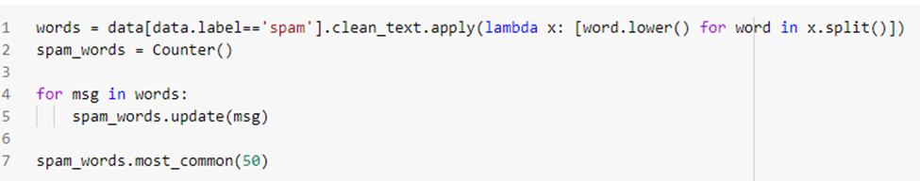
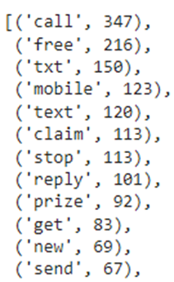
Spam Tokenization for first 50 Words:
OutPut

Slide 24
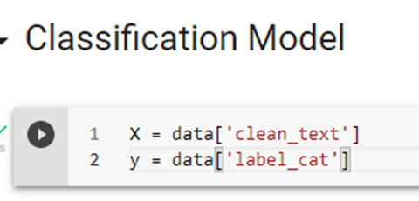
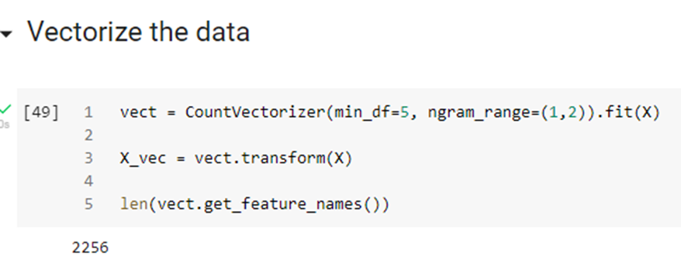
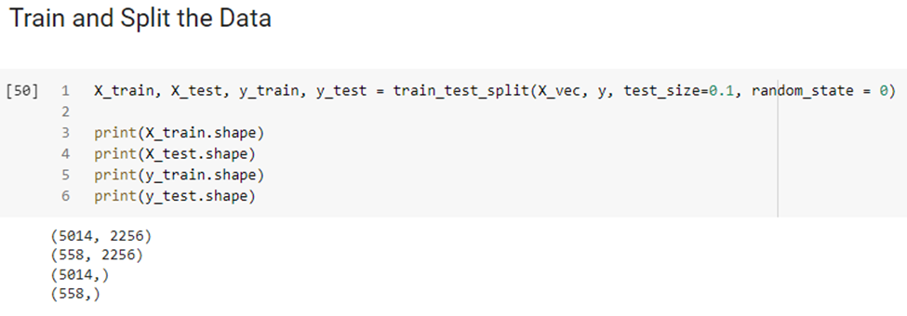
Classification Model Data Preparation:

Slide 25
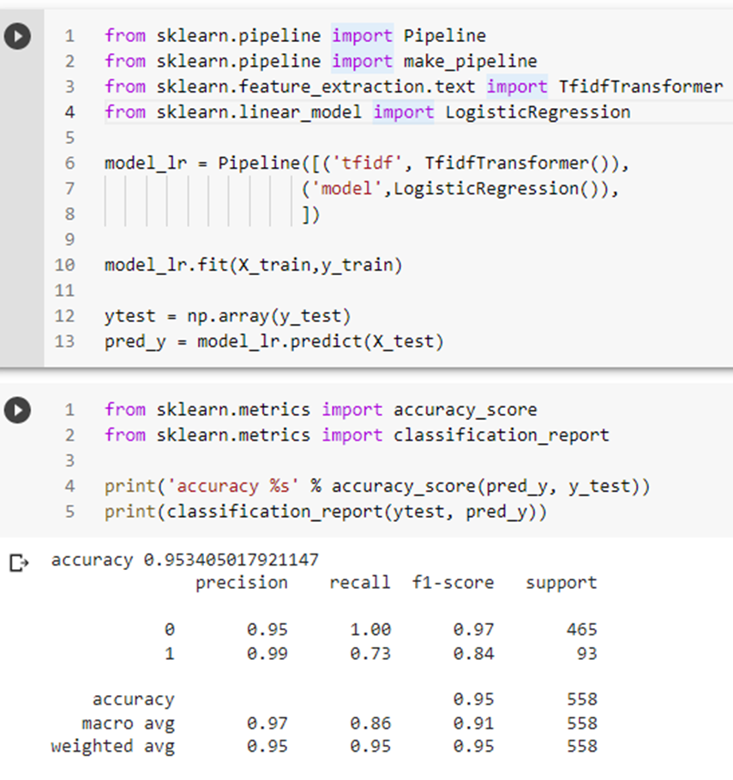
Logistic Regression:

Slide 26
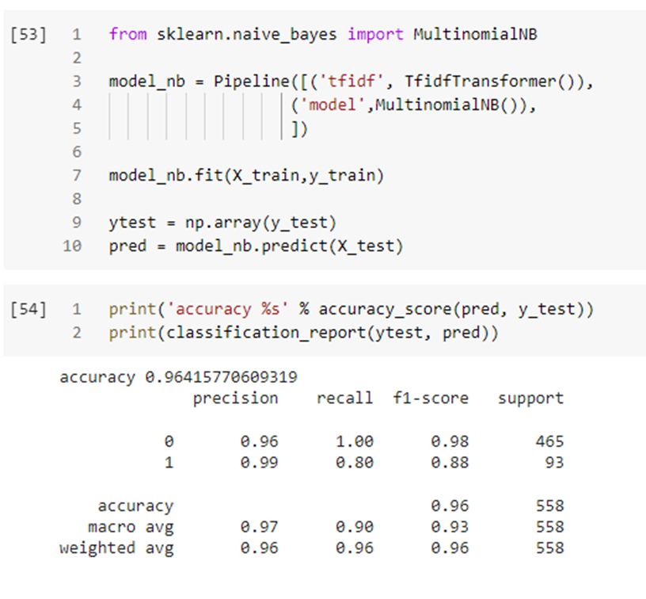
MultinomialNB:

Slide 27
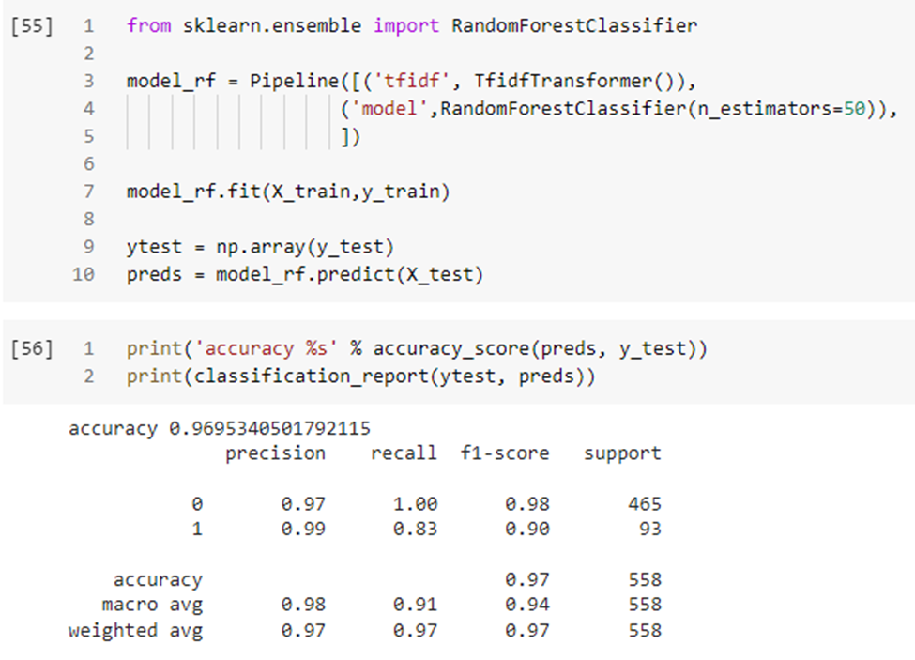
Random Forest Classifier:

Slide 28
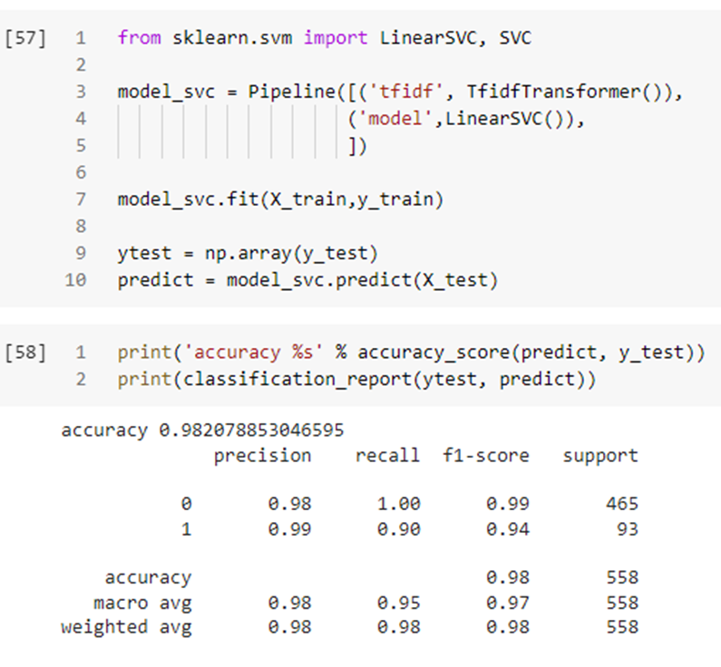
Linear SVC:

Slide 29
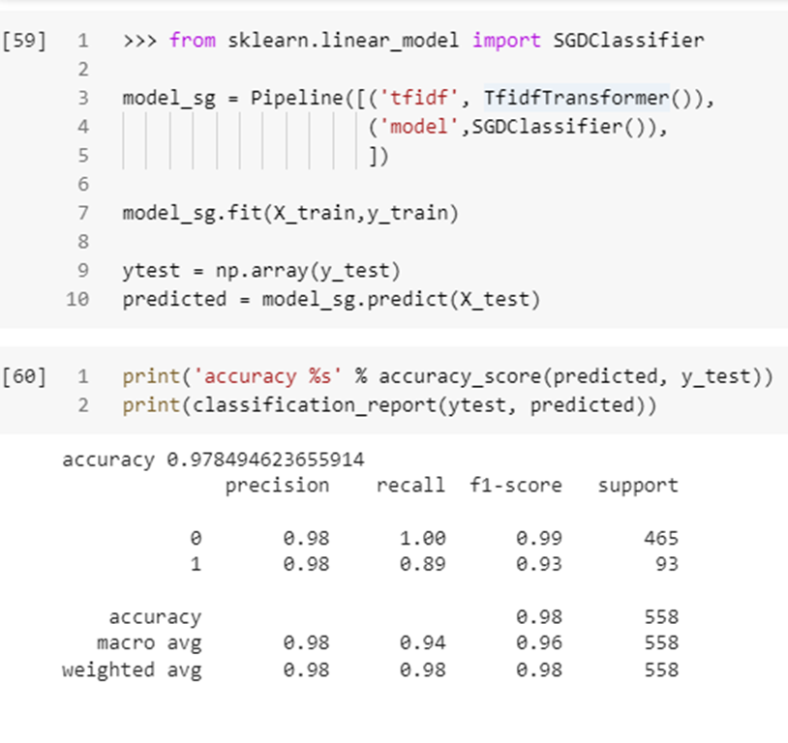
SGD Classifier:

Slide 30
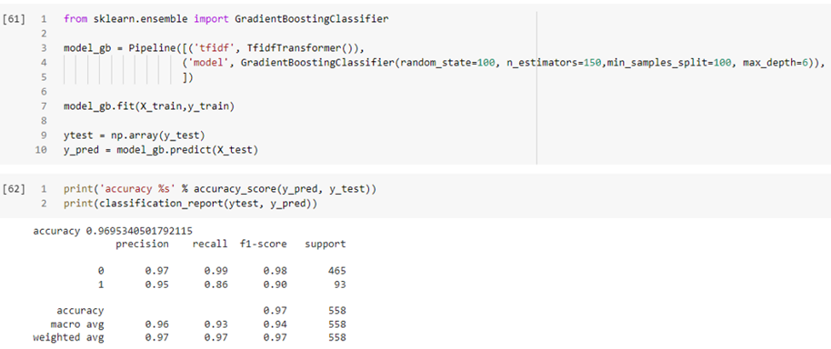
Gradient Boosting Classifier:

Slide 31
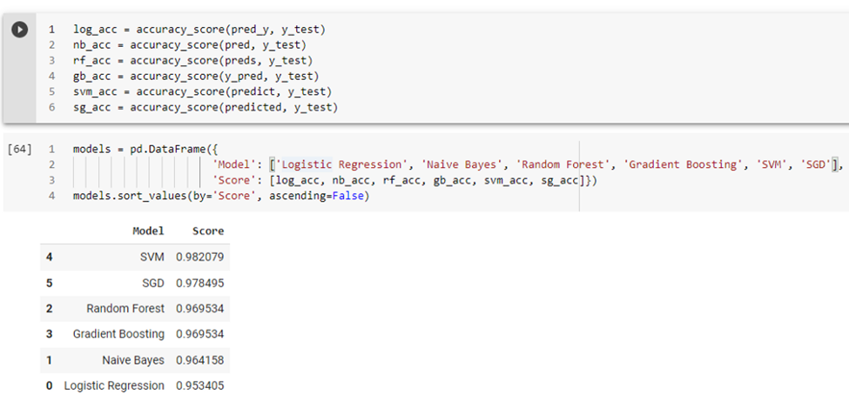
Compare Models:

Slide 32
We provided the text and refined the text (removal of stopwords, punctuations, and performed lemmatization). This helped in improving the Accuracy.
We have used different Model Pipeline containing TfidfVectorizer, where SVM model gives the best accuracy score of 98%.
The top Spam Tokenized words are- Call, Txt, Claim, Prize, Stop etc. These words gives an indication that it is either an commercial SMS or Spam SMS which is not used in regular life.
Most likely spam SMS’s have longer length in text as compared to Non Spam SMS.
Readability score is less or negative in Spam SMS as compared to Non Spam SMS.
Parts of speech that is adjective and adverbs, we can see that adjectives are used most frequently in Spam SMS as compared to Non Spam SMS.
Inference

Slide 33
Thank You!!!

